Slide 1
Building an Open Source Community to Achieve Innovation-Through-Openness
Jonas Rosland @jonasrosland
Open Source Community Manager Cloud-Native Apps VMware
May 2nd, 2018

Slide 2
Why participate in open source?
Participating in the open source community
Case study – The {code} Team
Failures and learnings

Slide 3
Why participate in open source?

Slide 4
65% of companies are contributing to open source projects
Source: www.blackducksoftware.com/2016-future-of-open-source

Slide 5
90% of respondents say open source improves their efficiency, interoperability and innovation
Source: www.blackducksoftware.com/2016-future-of-open-source

Slide 6
Main reasons users want open source solutions
Users want:
the freedom to run software anywhere, for any purpose
the opportunity to innovate, develop and participate in open source projects
the flexibility to choose the software and hardware that fits their needs
to be able to integrate software with existing infrastructure
FIFI

Slide 7
Participating in the open source community

Slide 8
What is needed to successfully participate in open source?
Dedicated people
Management buy-in
Well-defined goals
Established processes
Being good open source citizens

Slide 9
There are many ways to contribute to open source
Technical project leadership
Leading contributor communities
Promotion of amazing people and projects
Managing communication tools
Writing blog posts
Creating artwork
Answering questions from community members
Updating documentation
Writing code

Slide 10
Building your reputation in the open source community
Be consistent in your vision of projects you’re involved in
Be involved in conversations where you are expected to have presence
Be aware of the collective behaviors, contributions, and experience of individual team members
Recognize positive contribution and thought leadership in the ecosystem
Be a good open source citizen by respecting OSS best practices, coding, documentation, and management
Listen to community opinions and needs
Collaborate openly on project strategies and goals
Ensure a complimentary presence in open source communities
Be predictable by delivering on commitments
Credibility
Positive Contributor

Slide 11
Case study – The {code} Team

Slide 12
Important principles behind open source teams
Open source efforts are developed in the best interests of the community
Projects are executed with complete transparency and openness
Open source technologies are made to be consumable by the widest range of users and organizations
opensource.com/open-organization/17/12/building-code-community

Slide 13
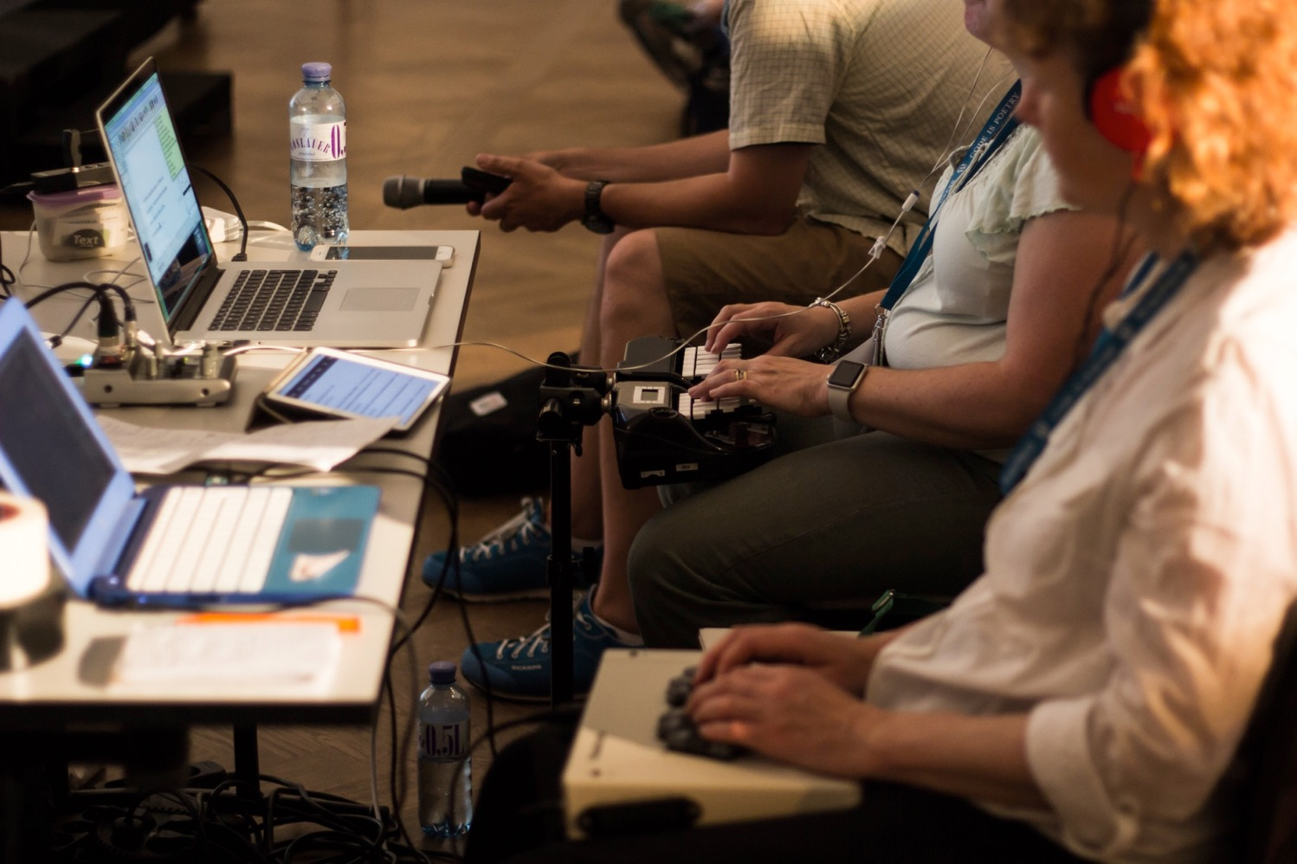









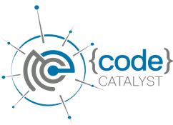
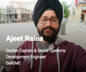


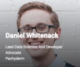

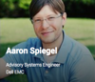
Building A Community
through engagement with open source developers, advocates, and leaders
One of the largest open source focused Slack teams in the world
A way to share your creation with the open source community
The DevHigh5 program simplifies the process of contributing open source code and projects. The program provides guidance to ensure projects are developed in the best interest of the community.
Over 6,000 members and growing daily
thecodeteam.com/community
Thought-leading members of the open source community
thecodeteam.com/devhigh5
thecodeteam.com/code-catalyst

Slide 14
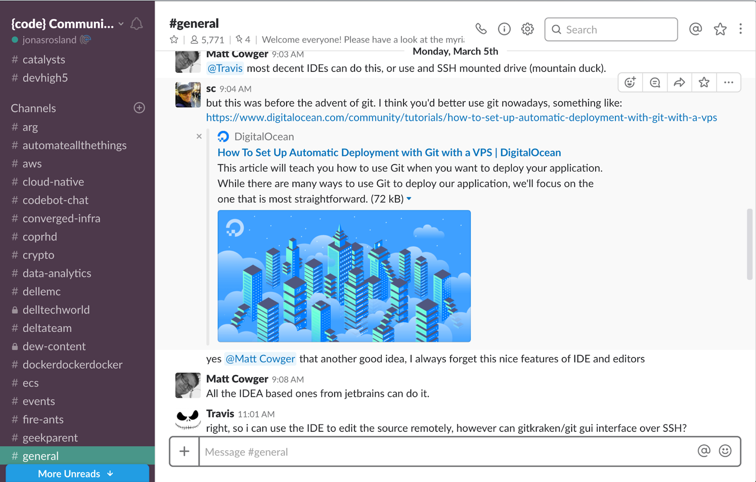
The {code} Community
Launched in June 2015
More than 6,000 Slack team members
Open dialogues across company boundaries
Topics ranging from contributions to cloud native projects, persistent storage in containers, virtual reality, and hardware hacking
Members include developers, project managers, users, recruiters, and tinkerers

Slide 15
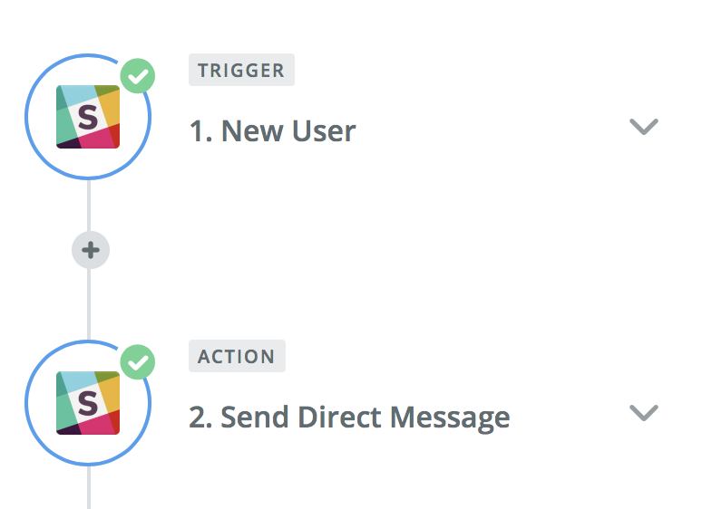
A few Slack best practices
Automate important things
Welcome messages through Slackbot – via a simple Zapier integration
Turn off private channel creation
You have ZERO visibility into what’s going on in there
Be present and proactive
Encourage questions and discussions
Don’t answer all questions yourself, invite community members to the conversation
Tag people to get their attention to conversations that they might want to be a part of
Make sure the CoC is followed and enforced if needed
And make sure the community is aware of when that happens!

Slide 16
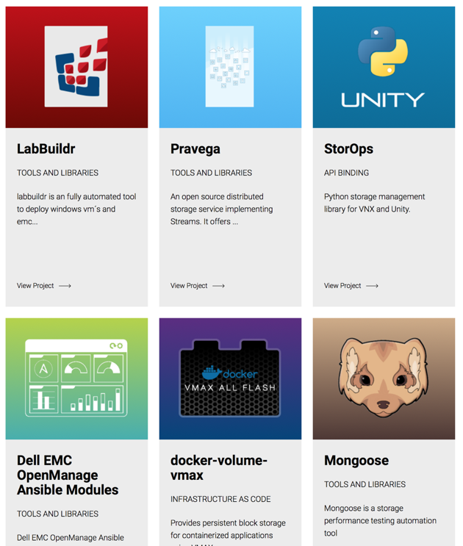
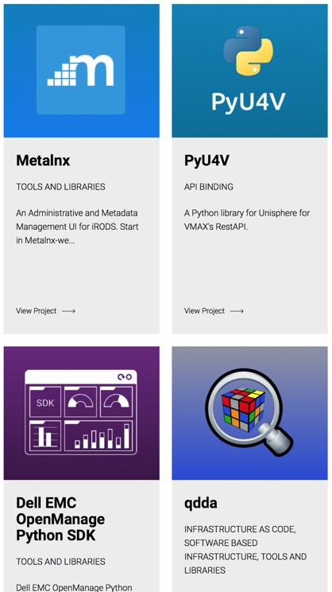
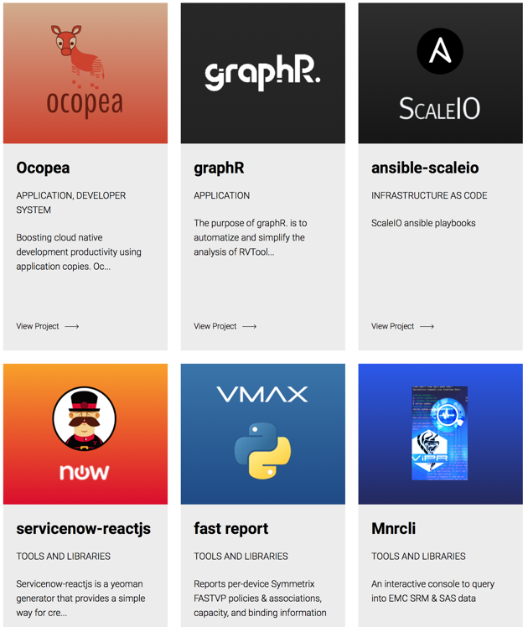
The DevHigh5 program
Launched in November 2014
Designed to lead projects from unpublished to fully open sourced
Recognition and promotion of open source contributions from users, partners, and employees
Guidance on how to structure the project:
Naming
Documentation
Licenses
Logos

Slide 17
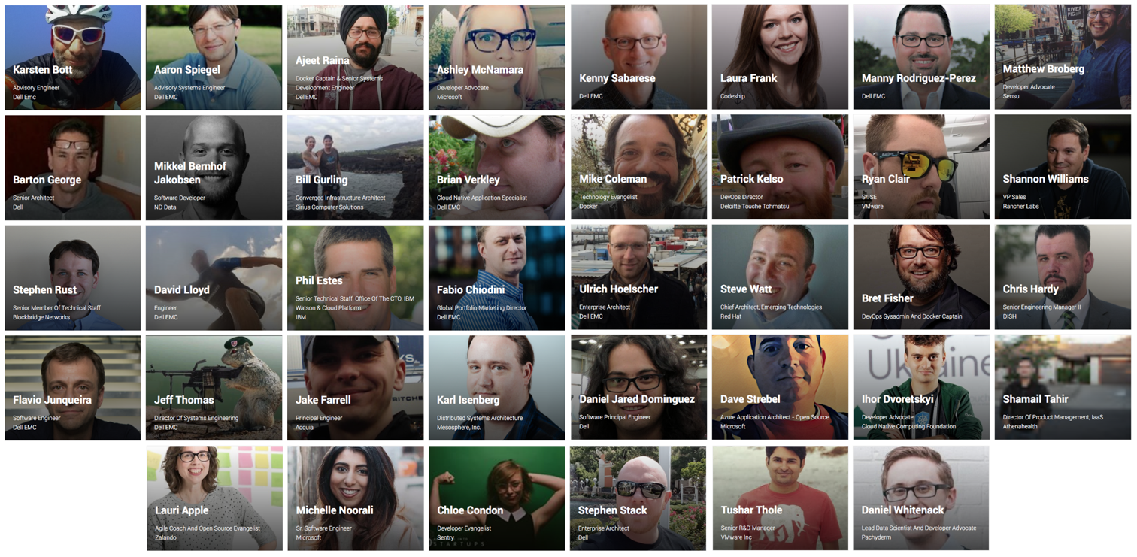
The {code} Catalyst program
Launched in December 2016
Bringing together prominent members of the open source community across the globe
38 members
26 organizations
10 countries
Designed to:
promote the work of the {code} Catalyst members
establish an ecosystem of creative individuals who advance the open source space

Slide 18
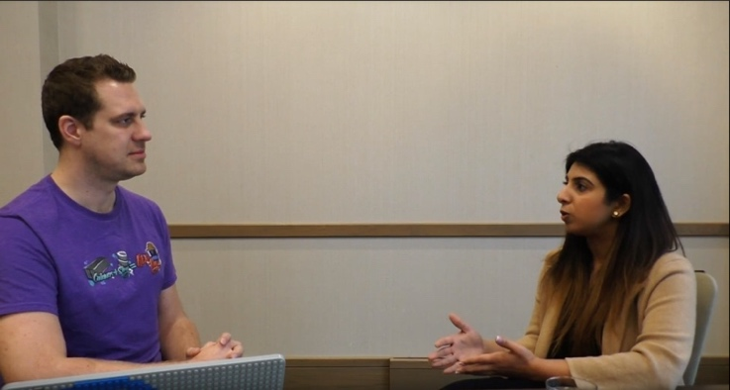
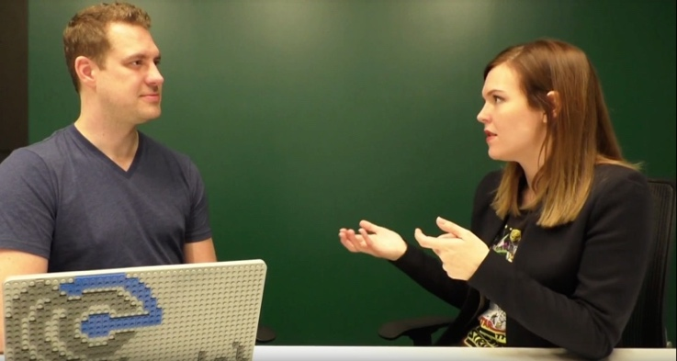
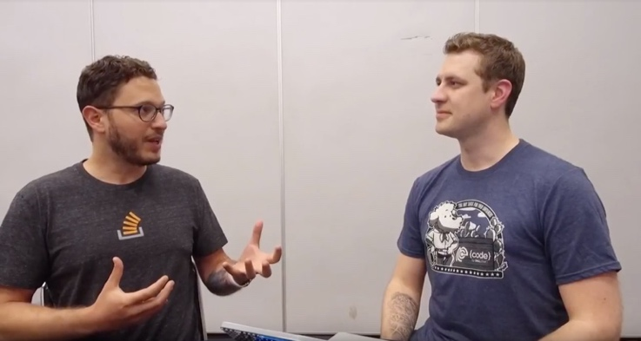
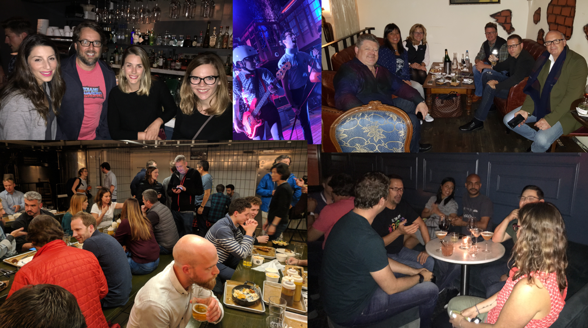
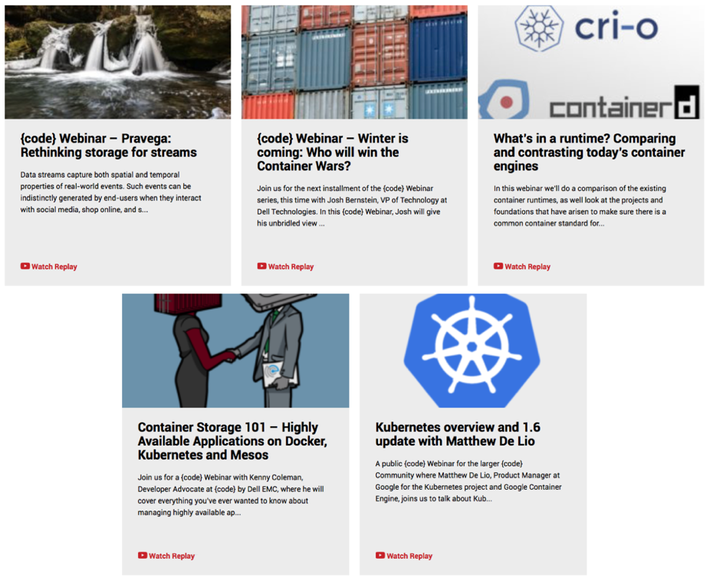
Making it fun!
{code} Catalyst interviews
{code} Webinar
{code} Assemblies

Slide 19
Failures and learnings

Slide 20

Notes:
We did the grassroots thing, but didn’t have clear guidelines what we should do

Slide 21
Notes:
We had great and dedicated people, but no clear direction

Slide 22
Notes:
There was no such thing as the TODO Group when we started
After a while we ironed out our own plan, but it took a lot longer than it should have

Slide 24
Notes:
Public information on successful open source teams were not that prolific
Writing up all this information, validating it, testing it to see if it works, takes a lot longer than adapting existing working strategies
Shout out to the VMware OSPO and similar initiatives

Slide 25
Some great resources
opensource.guide
citizencodeofconduct.org
github.com/todogroup/guides
opensource.microsoft.com/resources/office
Learn more about VMware’s open source involvement:
vmware.github.io
blogs.vmware.com/cloudnative/
blogs.vmware.com/opensource/

Slide 26
Q&A

Slide 27

Thank you!
@jonasrosland

